Slide 1


Car Insurance prediction
A predictive model was developed to assess the claim probability for car insurance policies. The process involved exploring the dataset, preprocessing it, and evaluating multiple machine learning models to find the best predictor.

Slide 2
Data Overview
Columns: 44
Rows: 58592
Target: is_claim
Discrete Features: make, airbags,displacement, cylinder, gear_box, turning_radius, length, ncap_rating, is_claim
Continuous Features: policy_tenure, age_of_car, age_of_policyholder, population_density, width, height, gross_weight
Categorical Features:
vehicle_spec : segment, fuel_type, max_torque, max_power,rear_brakes_type, transmission_typ, steering_type
Safty_spec: is_esc, is_tpms, is_brake_assist, is_power_door_locks, is_central_locking, is_speed_alert, is_ecw
Driving_convenience_spec: is_adjustable_steering, is_parking_sensors, is_parking_camera,is_power_steering, is_driver_seat_height_adjustable
Visibility_spec: is_front_fog_lights, is_rear_window_wiper, is_rear_window_washer, is_rear_window_defogger, is_day_night_rear_view_mirror
Non categorical Features: area_cluster, model, engine_type

Slide 3
Data Cleaning
Null Values
No null values
2. Duplicates
No duplicated records

Slide 4
Data Preprocessing and Feature Engineering
Feature Scaling and Encoding
Label Encoder for Categorical Feature Encoding
Standard Scalar to standardising numerical Features.
SMOTE for resampling unbalanced data

Slide 5
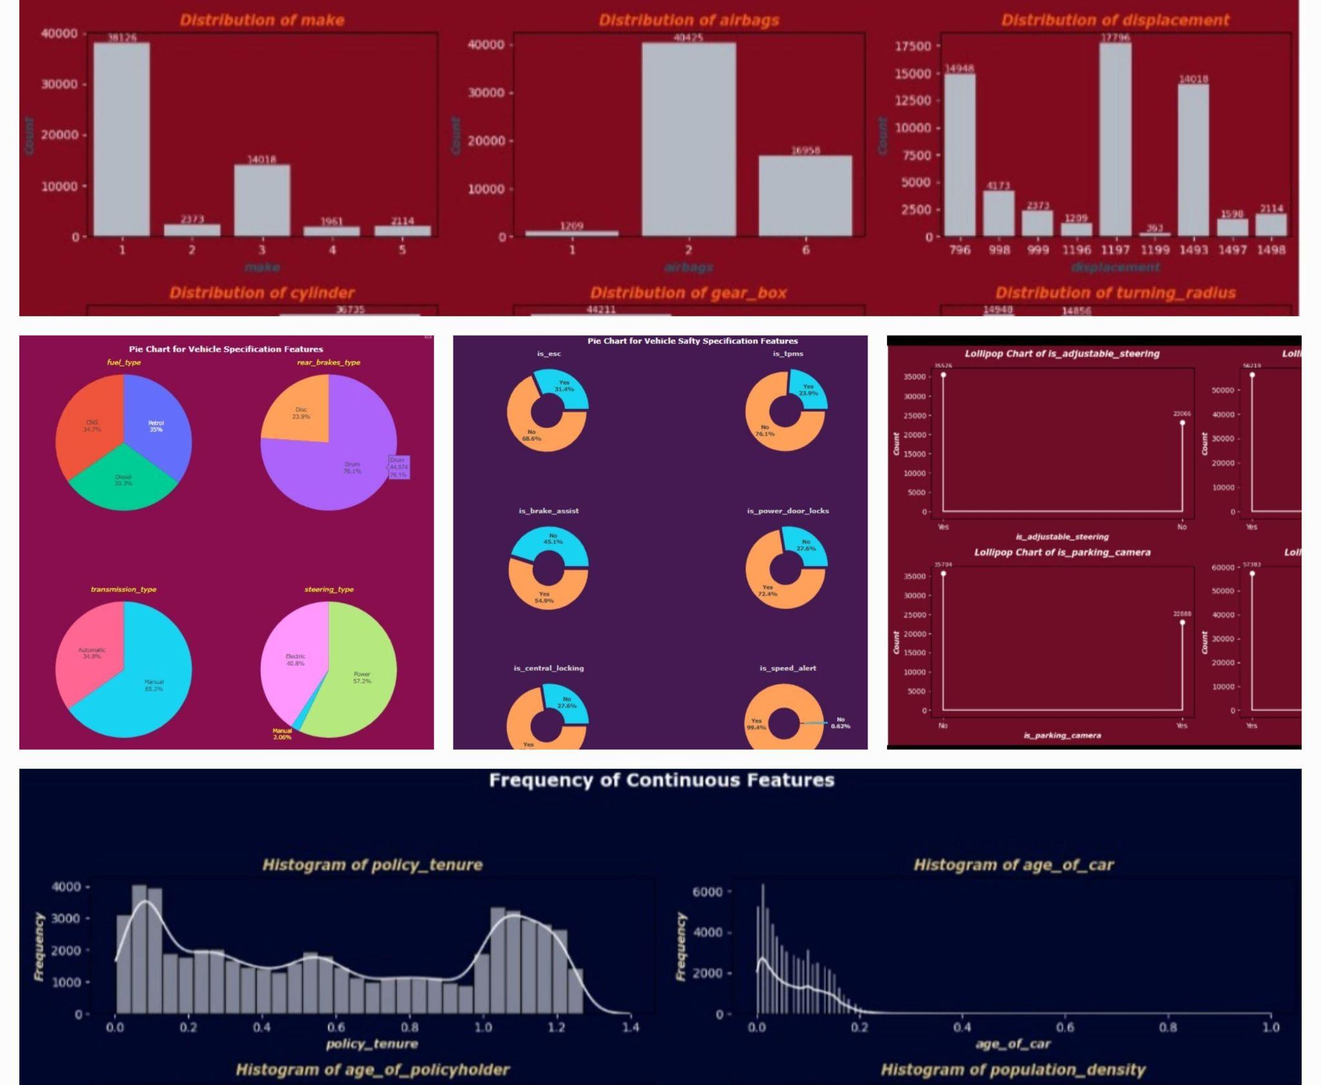
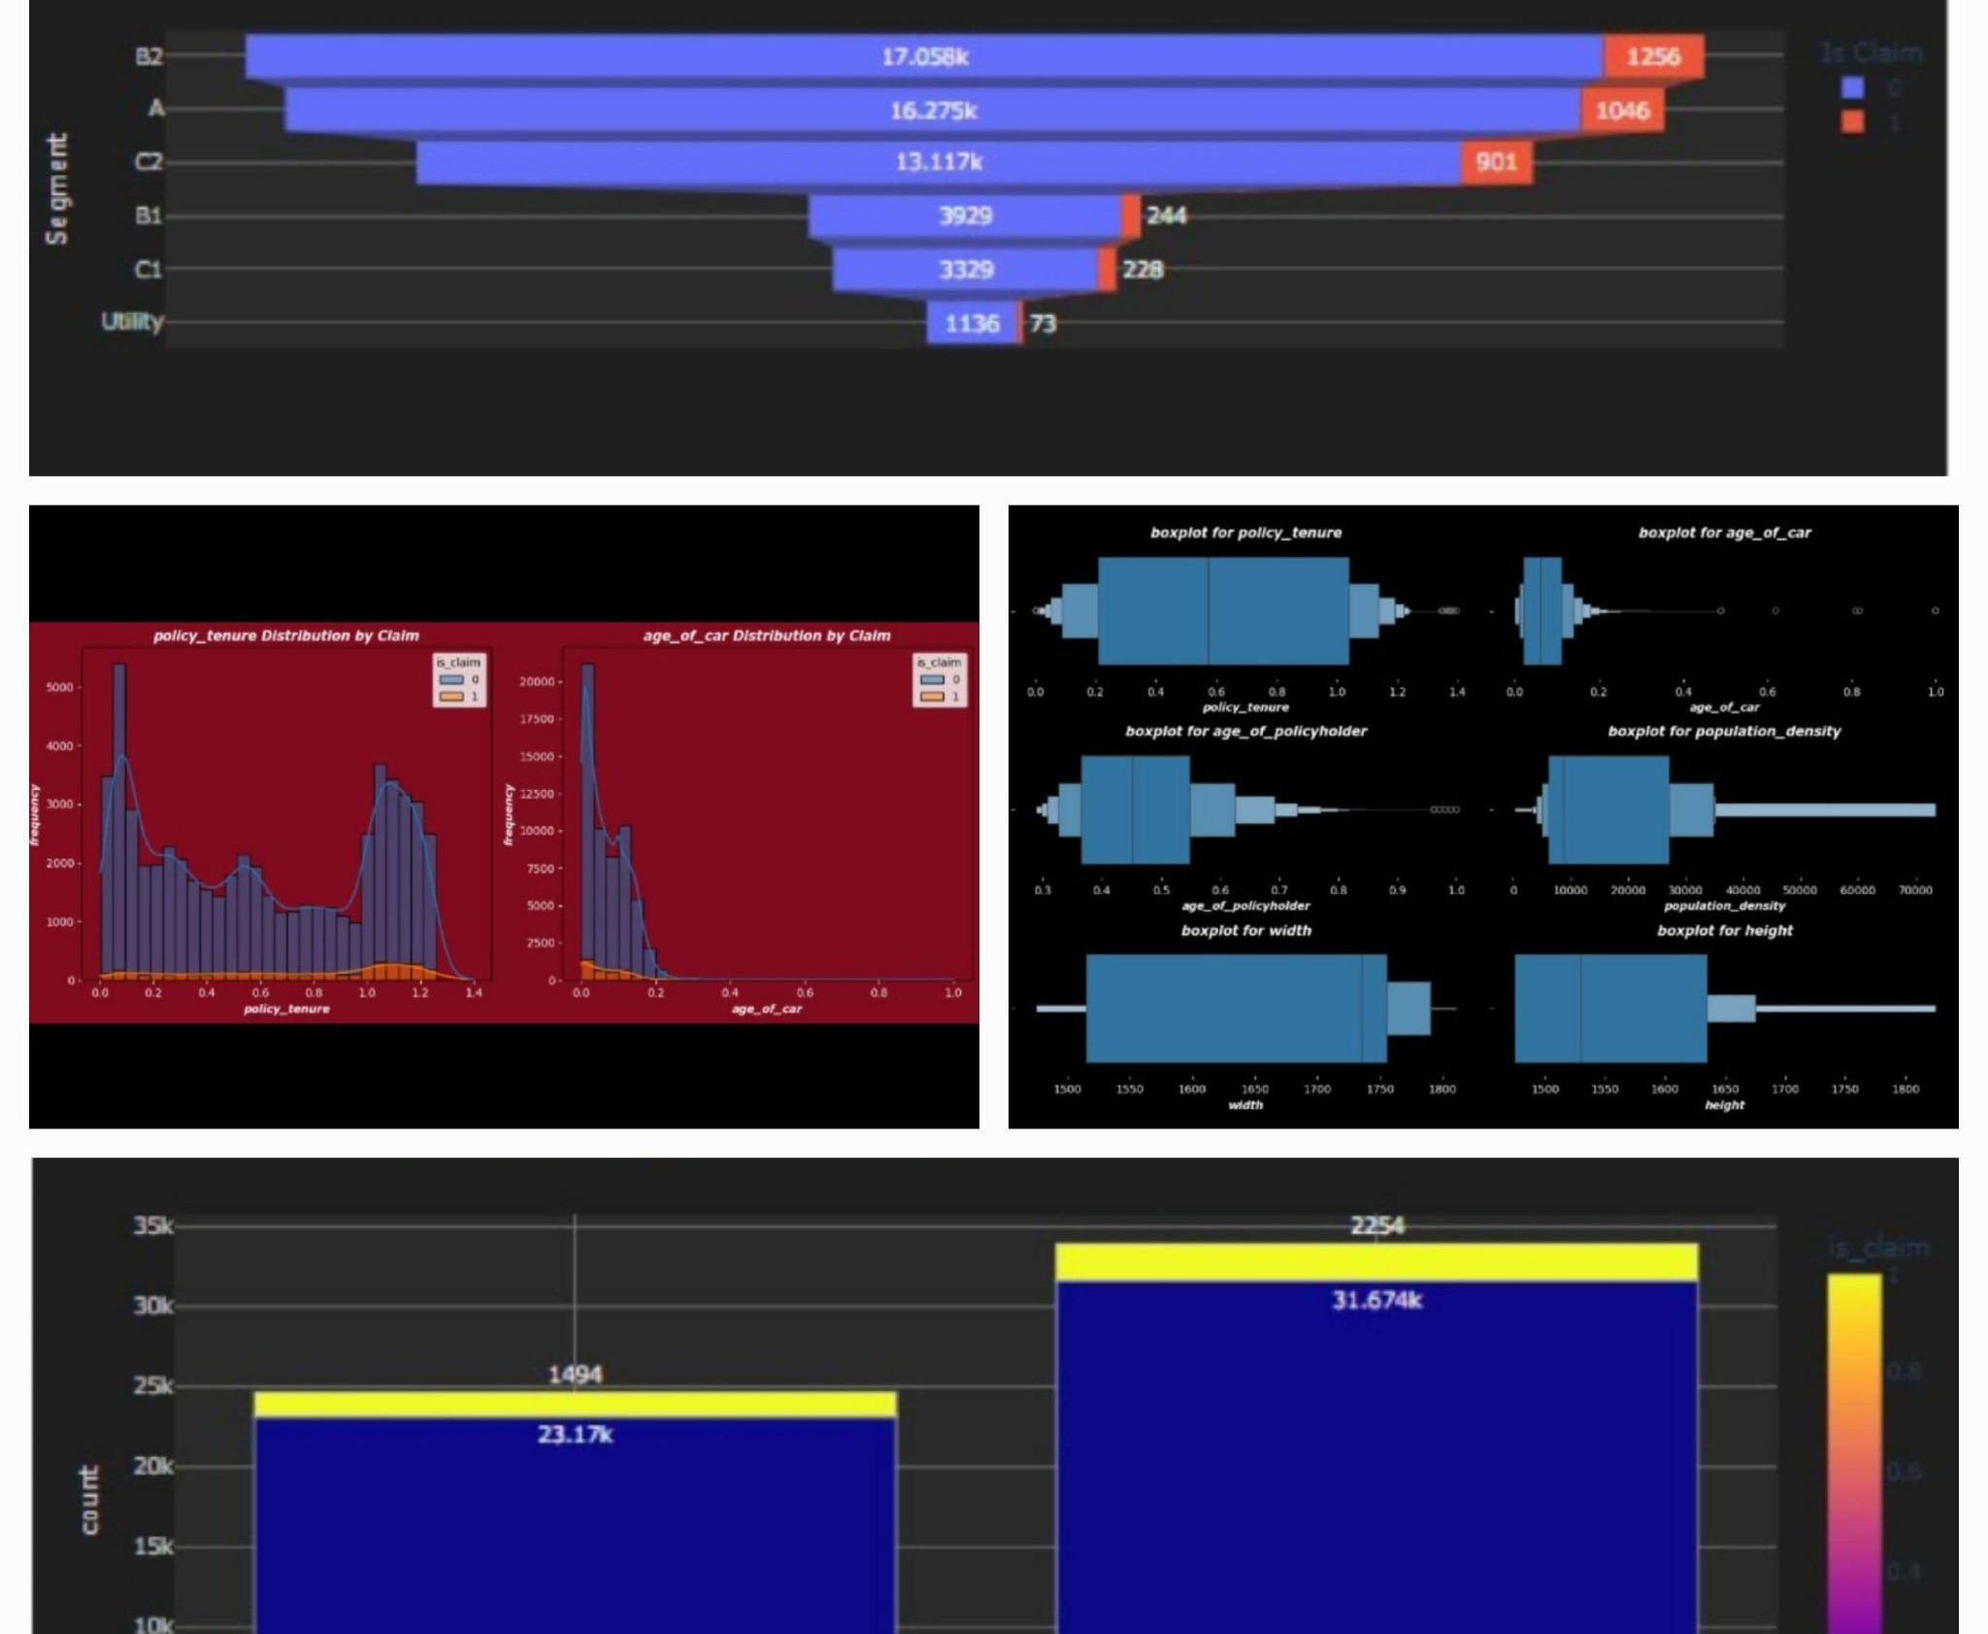
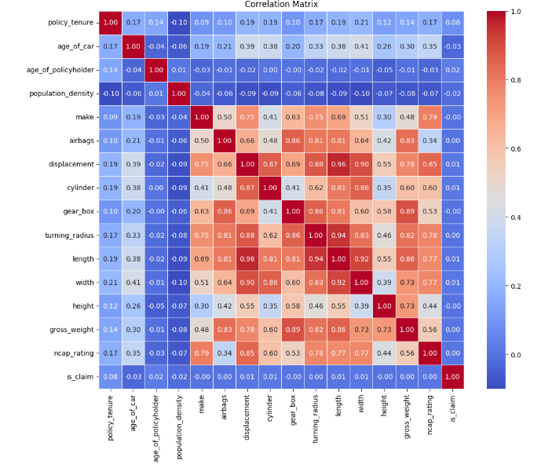
Exploratory Data Analysis
Univariate Analysis:
Detailed visualizations using count plots, pie charts, donut charts, lollipop charts, and histograms to show the distribution.
Bivariate Analysis:
Used stacked histograms, bar plots, and funnel charts to represent the relationship between the target variable and input features.
Correlation Analysis:
A heatmap is used to explore the correlation between features.

Slide 6
Model Selection
Logistic Regression
Why? It’s a simple, interpretable model often used as a baseline to understand the dataset.
Purpose: To check how a linear model performs with the given data.
Decision Tree
Why? It can handle non-linear relationships and interactions between features.
Purpose: To explore if a tree-based model performs better and to identify overfitting issues.
RandomForest
Why? It reduces overfitting by averaging multiple Decision Trees.
Purpose: To improve generalization compared to a single Decision Tree.
XGBoost
Why? It’s an advanced boosting algorithm known for its efficiency and accuracy.
Purpose: To achieve the best performance by leveraging gradient boosting techniques.

Slide 7
Model Training and Evaluation
Data Splitting
80% - Training
20% -Testing
Hyperparameter Tuning
GridSearchCV
Evaluation Metrics
classification_report, accuracy_score, precision_score, recall_score, f1_score, confusion_matrix, ConfusionMatrixDisplay

Slide 8
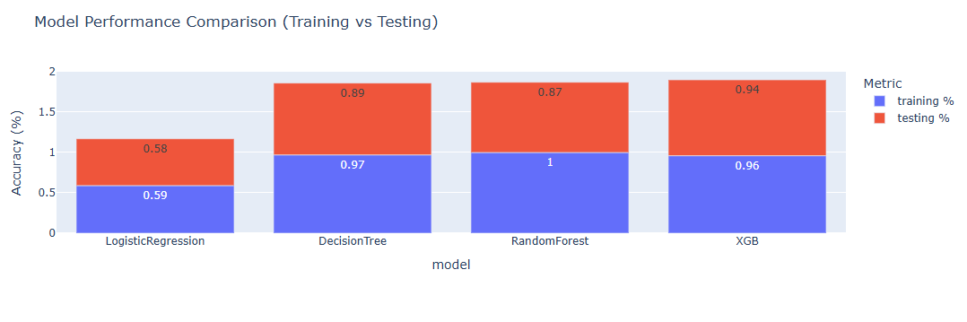
Model Performance
XGBoost demonstrates superior accuracy compared to other models.

Slide 9
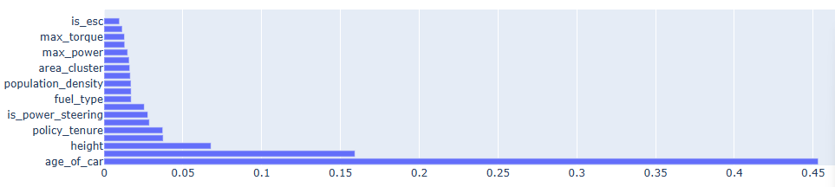
Feature Importance from XGB

Slide 10
Key Findings
Best Model
XGB
Important Features
age_of_car, height, policy_tenure, is_power_steering, fuel_type, population_density
Model Accuracy
Testing: 0.94

Slide 11
Thank you

